Slide 1
IMP: InputLink Manipulation Plug-in
Devvan Stokes
Cory Dunham

Slide 2
Motivation and Goals
Input link manipulation is tedious
“An 80% solution”
  Specify IL structure or supply VS Datamap
  Tool generates SML-level code
  Tweak auto-generated code to suit environment

Slide 3
Interface Code
Environment
Interface code
Soar

Slide 4
System Overview
IMP Parser
VS Datamap
ILObject
VS Datamap
ILObject
ILObject
IL Spec
(as text)
IL Digest
Code Generation
Module
Complete Integration
User
Incomplete Interface code
Environment
IMP Class
Completed
Interface code
Environment knowledge
Soar

Slide 5
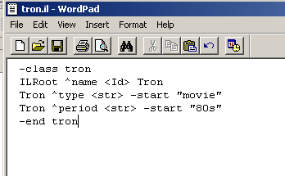
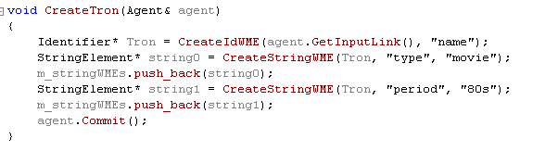
Example Specification

Slide 6
Example Specification

Slide 7
Example Specification

Slide 8
Example Specification

Slide 9
Current Status
Can parse the IL specification and generate C++ SML code for IL creation
Cannot parse datamap, cannot create datamap from spec

Slide 10
Future Work
Generate code from VisualSoar datamaps
Generate Java SML Code
Create GUI front-end
Convert to Eclipse Plug-in

Slide 11
Nuggets & Coal
Nuggets
  Higher level of abstraction than SML
Coal
  Still in early stages
  Requires programmer to copy/paste, tweak auto-gen code

